Slide 1
甲说乙说谎，乙说丙说谎，丙说甲、乙都说谎。问谁说真话、谁说谎。
令 P：甲说真话；Q：乙说真话；R：丙说真话；
得：P＝﹁Q，Q＝﹁R，R＝﹁P∧﹁Q.
(P↔﹁Q) ∧ (Q↔﹁R) ∧ ( R↔ (﹁P∧﹁Q) )＝１

Slide 2
(P↔﹁Q) ∧ (Q↔﹁R) ∧ ( R↔ (﹁P∧﹁Q) )=…=﹁P∧Q∧﹁R.
故 ﹁P∧Q∧﹁R＝１, 即：乙说真话，甲和丙说谎.

Slide 3
前提：如果马会飞或狗不叫，则母鸡就会是飞鸟；如果母鸡是飞鸟，那么烤熟的鸭子还会跑；烤熟的鸭子不会跑.
结论：马不会飞、狗要叫.
令 P：马会飞，Q：狗要叫，R：母鸡是飞鸟，S：烤熟的鸭子还会跑.
要证：{P∨﹁Q→R, R→S, ﹁S} ⇒﹁P∧Q.
(1) ﹁S P
(2) R→S P
(3) ﹁R C (1)(2)
(4) P∨﹁Q→R P
(5) ﹁(P∨﹁Q) C(3)(4)
(6) ﹁P∧Q C(5)

Slide 4
Chapter 2. Basic Structures:
Sets,Functions,Sequences,and Sums
2.1 Sets
2.2 Set Operations
2.3 Functions
2.4 Sequences and Summations

Slide 5
2.1 Sets
Introduction
DEFINITION 1
A set is an unordered collection of objects
Cantor,1895
Naive set theory
Paradoxes
2013/3/26

Slide 6
2.1 Sets
DEFINITION 2
The objects in a set are called the elements, or members, of the set. A set is said to contain its elements.
A collection of distinct elements having specific common properties.

Slide 7
2.1 Sets
元素
当事物a是集合A的元素时，称a属于A，记为a∈A
当事物a不是集合A的元素时，称a不属于A，记为a∉A

Slide 8
2.1 Sets
（1）Enumeration 列举法,部分列举法
（2）Predication 概括法、属性法、谓词法
  A＝｛x | x具有性质Ｐ｝
  （3） Venn diagram
2013/3/26

Slide 9
2.1 Sets
Empty set, or null set 空集，记为∅ ,{}
Singleton set 单元集
Finite set 有限（穷）集
Infinite set 无限（穷）集
有限集A中所含元素的个数记为|A|
Universal set U E

Slide 10
2.1 Sets
（１）N：所有自然数（包括０）组成的集合（自然数集）natural numbers
（２）Z：所有整数所组成的集合（整数集）integers
（３）N⁺或Z⁺：所有正整数所组成的集合（正整数集）positive integers
（４）Q：所有有理数所组成的集合（有理数集）
（５）Q⁺：所有正有理数组成的集合（正有理数集） positive rational numbers
（６）R：所有实数组成的集合（实数集）
（７）R⁺：所有正实数组成的集合（正实数集）
positive real numbers

Slide 11
2.1 Sets
N= {0,1,2,… } ,Set of natural numbers
Z= {…,-2,-1,0,1,2,… } ,Set of Integers
Q= the set of rational numbers
R =the set of real numbers
Z⁺ = {1,2,3,… } ,Set of positive Integers
Q⁺ = the set of positive rational numbers
R⁺ = the set of positive real numbers
2013/3/26

Slide 12
2.1 Sets
DEFINITION 3
Two sets are equal if and only if they have the same elements. That is, if A and B are sets, then A and B are equal if and only if
∀x ( x ∈A ↔ x ∈B ).
We write A= B if A and B are equal sets.

Slide 13
2.1 Sets
DEFINITION 4
A set A is said to be a subset of B if and only if every element of A is also an element of B. we use the notation A ⊆ B to indicate that A is a subset of the set B. We see that A ⊆ B if and only if the quantification
∀x ( x ∈A → x ∈B )
is ture.

Slide 14
2.1 Sets
A⊆B ≡ ∀x ( x∈A → x∈B )
A=B ≡ A⊆B ∧ B⊆A
2013/3/26

Slide 15
2.1 Sets
Theorem 1 For any set S,
① Ø ⊆ S; ② S ⊆ S.
2013/3/26

Slide 16
2.1 Sets
Proper subset
If A ⊆ B and A ≠ B, we write A ⊂ B and say that A is a proper subset of B.
2013/3/26

Slide 17
2.1 Sets
DEFINITION 5
finite set
cardinality
DEFINITION 6
A set is said to be infinite if it is not finite.

Slide 18
2.1 Sets
Proper subset
If A ⊆ B and A ≠ B, we write A ⊂ B and say that A is a proper subset of B.
The power set
Definition 7
Given a set S, the power set of S is the set of all subset of the set S. The power set of S is denoted by P(S).
P(S)={ A | A⊆S }
2013/3/26

Slide 19
2.1 Sets
Cartesian products
Definition 8
The ordered n-tuple (a₁,a₂,…, a_{n}) is the ordered collection that has a₁ as its first element, a₂ as its second element,.., and a_{n} as its nth element.
笛卡尔积
有序n元组
有序对
Ordered pairs (2-tuple)
2013/3/26

Slide 20
2.1 Sets
Cartesian products
Definition 9
Let A and B be sets,The Cartesian product of A and B, denoted by A×B, is the set of all ordered pairs (a,b) where a∈A and b∈B.Hence
A×B={ (a,b) | a∈A ∧ b∈B}
笛卡尔积
有序n元组
有序对
2013/3/26

Slide 21
2.1 Sets
Cartesian products
Definition 10
The Cartesian product of A₁, A₂ , … , A_{n}, denoted by A₁×A₂ × …×A_{n} , is the set of
A₁×A₂ × …×A_{n} ={ (a₁,a₂,…a_{n}) | a_{i}∈A_{i} for i=1,2,3…n}
2013/3/26

Slide 22
2.1 Sets
Use Set Notation with Quantifiers
∀x∈S ( P(x) )
∃x∈S ( P(x) )
Truth Sets of Quantifiers
{ x∈D | P(x)}
Homework: P97, Exercises
2013/3/26

Slide 23
Chapter 2. Basic Structures:
Sets,Functions,Sequences,and Sums
2.1 Sets
2.2 Set Operations
2.3 Functions
2.4 Sequences and Summations

Slide 24
2.2 Set Operations
Introduction
Definition 1 Let A and B be sets. The union of the sets A and B, denoted by A∪B, is the set that contains those elements that are either in A or in B, or in both.
A∪B = { x | x∈A ∨ x∈B}
Examples
2013/3/26

Slide 25
2.2 Set Operations
Introduction
Definition 2 Let A and B be sets. The intersection of the sets A and B, denoted by A∩B, is the set containing those elements in both A and B.
A ∩ B = { x | x∈A ∧ x∈B }
Examples
2013/3/26

Slide 26
2.2 Set Operations
Introduction
Definition 3
Tow sets are called disjoint if their intersection is the empty set.
A ∩ B = {}
Examples
2013/3/26

Slide 27
2.2 Set Operations
Introduction
Definition 4
Let A and B be sets. The difference of the sets A and B, denoted by A–B, is the set containing those elements that are in A but not in B. The difference of the sets A and B is also called the complement of B with respect to A.
A-B = { x | x∈A ∧ x∉B }
Examples
2013/3/26

Slide 28

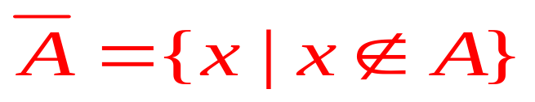
2.2 Set Operations
Introduction
Definition 5 Let U be the universal set. The complement of the set A denoted by , is the complement of A with respect to U ,in other words, the complement of the set A is U-A.
Examples
2013/3/26

Slide 29
2.2 Set Operations
Set Identities
SEE P101
2013/3/26

Slide 30
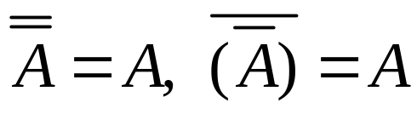
2.2 Set Operations
Set Identities
并、交、差、补运算性质
定理 设A，B，C为全集U的子集，则
A∩U＝A A∪∅＝A Identity laws (单位律)
A∪U＝U A∩∅＝∅ Domination laws（零律）
A∪A＝A A∩A＝A Idempotent laws (幂等律）
Complementation（反身律）
How to prove?
Membership tables

Slide 31
2.2 Set Operations
Set Identities
并、交、差、补运算性质
定理 设A，B，C为全集U的子集，则
A∪B＝B∪A A∩B＝B∩A Commutative laws(交换律)
A∪(B∪C )＝(A∪B)∪C
A∩(B∩C）＝(A∩B)∩C Associative laws（结合律）
A∩ (B∪C）＝ (A∩B)∪(A∩C)
A∪(B∩C）＝ (A∪B)∩(A∪C) Distributive laws（分配律)

Slide 32
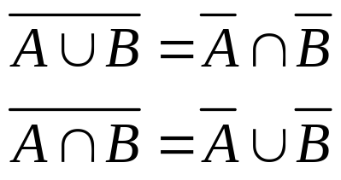
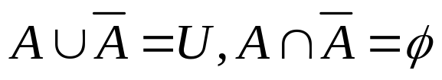
2.2 Set Operations
Set Identities
并、交、差、补运算性质
定理 设A，B，C为全集U的子集，则
De Morgan’s laws
A∪(A∩B)＝A, A∩(A∪B)＝A Absorption laws（吸收律）
Complement laws（补律）

Slide 33
2.2 Set Operations
Example:设F 表示大学一年级学生的集合，S 表示大学二年级学生的集合，R 表示计算机系学生的集合，M 表示数学系学生的集合，T 表示选修离散数学的学生的集合。写出下列各句子所对应的表达式。
⑴所有计算机系二年级的学生都选修离散数学；
⑵数学系一年级的学生都没有选修离散数学；
2013/3/26

Slide 34
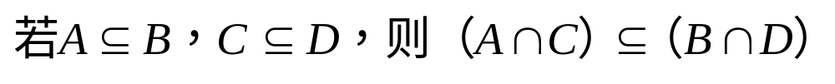
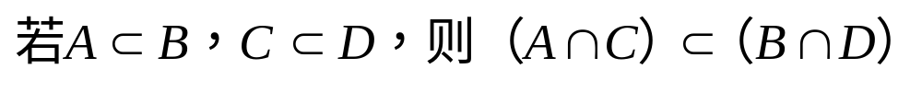
2.2 Set Operations
Example:
设有集合A，B，C，D，下述论断是否正确？说明理由。
⑴
⑵
2013/3/26

Slide 35
2.2 Set Operations
Set Identities
Example:设任意集合A、B、C，满足A∩B=A∩C，则是否可以得到集合B=C的结论呢？
如果满足A∪B=A∪C，则是否能得到B=C的结论呢？
证明 A∩B=A∩C并且A∪B=A∪C是B=C的充要条件。
2013/3/26

Slide 36
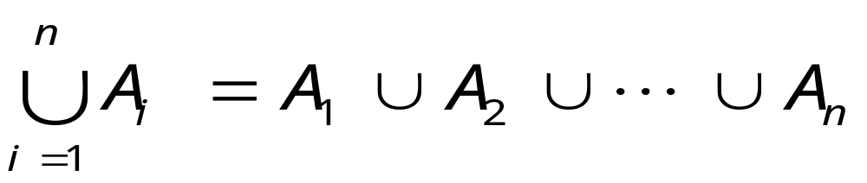
2.2 Set Operations
Generalized unions and intersections
Definition 6
The union of a collection of sets is the set that contains those elements that are members of at least one set in the collection.
2013/3/26

Slide 37
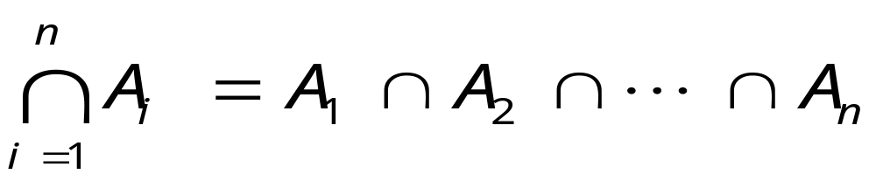
2.2 Set Operations
Generalized unions and intersections
Definition 7
The intersection of a collection of sets is the set that contains those elements that are members of all the sets in the collection.
2013/3/26

Slide 38
2.2 Set Operations
Computer Representation of Sets
U={1,2,3,4,5,6,7,8,9,10}
A={1,2,3,4,5}
B={1,3,5,7,9}
1111100000
1010101010
Homework: P105, Exercises
2013/3/26

